Slide 1
MATLAB for Engineering Applications Fifth Edition
William J. Palm III
© McGraw Hill LLC. All rights reserved. No reproduction or distribution without the prior written consent of McGraw Hill LLC.

Slide 2
Chapter 02
Numeric, Cell, and Structure Arrays

Slide 3
Vectors 1
To create a row vector, separate the elements by commas. Use square brackets. For example,
>>p = [3,7,9]
p =
3 7 9
You can create a column vector by using the transpose notation
>>p = [3,7,9]'
p =
3
7
9

Slide 4
Vectors 2
You can also create a column vector by separating the elements by semicolons. For example,
>>g = [3;7;9]
g =
3
7
9

Slide 5
Vectors 3
You can create vectors by ''appending'' one vector to another.
For example, to create the row vector u whose first three columns contain the values of r = [2,4,20] and whose fourth, fifth, and sixth columns contain the values of w = [9,-6,3], you type u = [r,w]. The result is the vector u = [2,4,20,9,-6,3].

Slide 6
Vectors 4
The colon operator
easily generates a large vector of
regularly spaced elements. Parentheses are not needed but can be used for clarity. Do not use square brackets.
Typing
>>x = m:q:n
creates a vector x of values with a spacing q. The first value is m. The last value is n if m − n is an integer multiple of q. If not, the last value is less than n.

Slide 7
Vectors 5
For example, typing x = 0:2:8 creates the vector x = [0,2,4,6,8], whereas typing x = 0:2:7 creates the vector x = [0,2,4,6].
To create a row vector z consisting of the values from 5 to 8 in steps of 0.1, type z = 5:0.1:8.
If the increment q is omitted, it is presumed to be 1. Thus typing y = -3:2 produces the vector y = [-3,-2,-1,0,1,2].

Slide 8
Vectors 6
The linspace command also creates a linearly spaced row vector, but instead you specify the number of values rather than the increment.
The syntax is linspace(x1,x2,n), where x1 and x2 are the lower and upper limits and n is the number of points.
For example, linspace(5,8,31) is equivalent to 5:0.1:8.
If n is omitted, the spacing is 1.

Slide 9
Vectors 7
The logspace command creates an array of logarithmically spaced elements.
Its syntax is logspace(a,b,n), where n is the number of points between
and
For example, x = logspace(-1,1,4) produces the vector x = [0.1000, 0.4642, 2.1544, 10.000].
If n is omitted, the number of points defaults to 50.

Slide 10
Magnitude, Length, and Absolute Value of a Vector 1
Keep in mind the precise meaning of these terms when using MATLAB.
The length command gives the number of elements in the vector.
The magnitude of a vector x having elements
is a scalar, given by √
, and is the
same as the vector’s geometric length.
The absolute value of a vector x is a vector whose elements are the absolute values of the elements of x.

Slide 11
Magnitude, Length, and Absolute Value of a Vector 2
For example, if x = [2,-4,5],
its length is 3; (computed from length(x)).
its magnitude is √
= 6.7082; (computed from
sqrt(x*x’)).
Magnitude can also be calculated using the norm function.
norm(x)
its absolute value is [2,4,5] (computed from abs(x)).

Slide 12
Matrices
A matrix has multiple rows and columns. For example, the matrix
has four rows and three columns.
Vectors are special cases of matrices having one row or one column.

Slide 13
Creating Matrices
If the matrix is small you can type it row by row, separating the elements in a given row with spaces or commas and separating the rows with semicolons. For example, typing
>> A = [2,4,10;16,3,7];
creates the following matrix:
Remember, spaces or commas separate elements in different columns, whereas semicolons separate elements in different rows.

Slide 14
Creating Matrices from Vectors
Suppose a = [1,3,5] and b = [7,9,11] (row vectors). Note the difference between the results given by [a b] and [a;b] in the following session:
>>c = [a b];
c =
1 3 5 7 9 11
>>D = [a;b]
D =
1 3 5
7 9 11

Slide 15
Array Addressing 1
You need not use symbols to create a new array. For example, you can type
>> D = [[1,3,5];[7,9,11]];
The colon operator selects individual elements, rows, columns, or “subarrays” of arrays. Here are some examples:
v(:)
represents all the row or column elements of the vector v.
v(2:5) represents the second through fifth elements; that is v(2), v(3), v(4), v(5).

Slide 16
Array Addressing 2
A(:,3) denotes all the elements in the third column of the matrix A.
A(:,2:5) denotes all the elements in the second through fifth columns of A.
A(2:3,1:3) denotes all the elements in the second and third rows that are also in the first through third columns.
v = A(:) creates a vector v consisting of all the columns of A stacked from first to last.
A(end,:) denotes the last row in A, and A(:,end) denotes the last column.

Slide 17
Array Addressing 3
You can use array indices to extract a smaller array from another array. For example, if you first create the array B
then type C = B(2:3,1:3), you can produce the following array:

Slide 18
Additional Array Functions 1
[u,v,w] = find(A) | Computes the arrays u and v, containing the row and column indices of the nonzero elements of the matrix A, and the array w, containing the values of the nonzero elements. The array w may be omitted.
length(A) | Computes either the number of elements of A if A is a vector or the largest value of m or n if A is an m × n matrix.

Slide 19
Additional Array Functions 2
max(A) | Returns the algebraically largest element in A if A is a vector. Returns a row vector containing the largest elements in each column if A is a matrix. If any of the elements are complex, max(A) returns the elements that have the largest magnitudes.

Slide 20
Additional Array Functions 3
[x,k] = max(A) | Similar to max(A) but stores the maximum values in the row vector x and their indices in the row vector k.
min(A) and [x,k] = min(A) | Like max but returns minimum values.

Slide 21
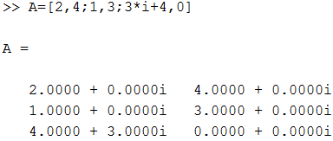
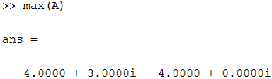
Q1-For the matrix A given below, the values returned by max(A) functions is
Max=4+3i 4 (correct)
Max= 1 4
Max=4i+3 4
Max= 1 0

Slide 22
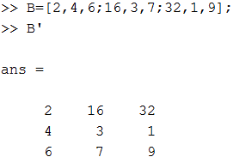

Q2- For the matrix B, use MATLAB to find $B^{′}.$
$$B=\left[\begin{aligned}2 4 6 \\ 16 3 7 \\ 32 1 9 \end{aligned}\right]$$
$B^{′}=\left[\begin{aligned}\text{7 } \text{ 6 } \text{1} \\ \text{4 } \text{ 3 32 } \\ \text{2 16 9 }\end{aligned}\right]$
$B^{′}=\left[\begin{aligned}\text{2 16 32} \\ \text{4 3 1 } \\ \text{6 7 9 }\end{aligned}\right]$ (correct)
$B^{′}=\left[\begin{aligned}\text{16 2 32} \\ \text{3 4 1 } \\ \text{6 7 9 }\end{aligned}\right]$
$B^{′}=\left[\begin{aligned}\text{6 } \text{ 7 } \text{32} \\ \text{4 3 1 } \\ \text{2 16 9 }\end{aligned}\right]$

Slide 23
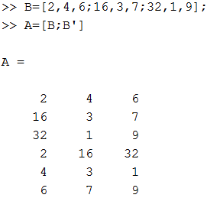
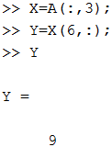
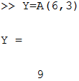
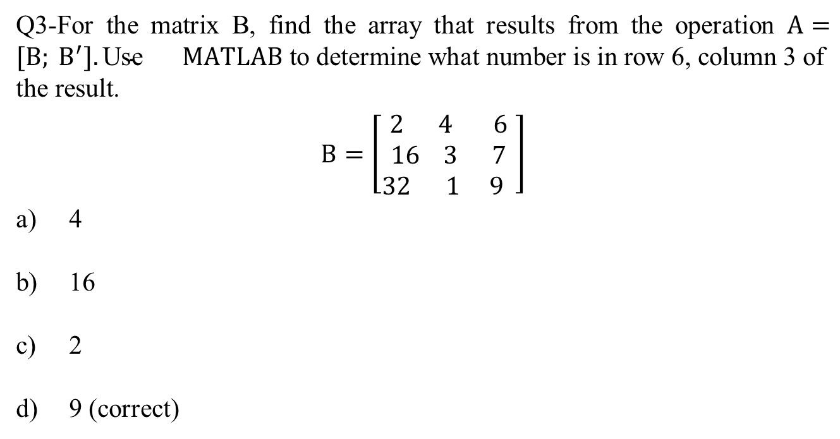
Q3-For the matrix B, find the array that results from the operation $A=[B; B^{′}].\text{Use}$ $MATLAB \text{to} \text{determine} \text{what} \text{number} \text{is} \text{in} \text{row}\text{ 6, }\text{column}\text{ 3 }\text{of} \text{the} \text{result}\text{.}$
$$B=\left[\begin{aligned}2 4 6 \\ 16 3 7 \\ 32 1 9 \end{aligned}\right]$$
4
16
2
9 (correct)

Slide 24
Additional Array Functions 4
size(A) | Returns a row vector [m n] containing the sizes of the m × n array A.
sort(A) | Sorts each column of the array A in ascending order and returns an array the same size as A.
sum(A) | Sums the elements in each column of the array A and returns a row vector containing the sums.

Slide 25
Additional Array Functions 5
The function size(A) returns a row vector [m n] containing the sizes of the m × n array A. The length(A) function computes either the number of elements of A if A is a vector or the largest value of m or n if A is an m × n matrix.
For example, if
then max(A) returns the vector [6,2]; min(A)returns the vector [-10, -5]; size(A) returns [3, 2]; and length(A) returns 3.

Slide 26
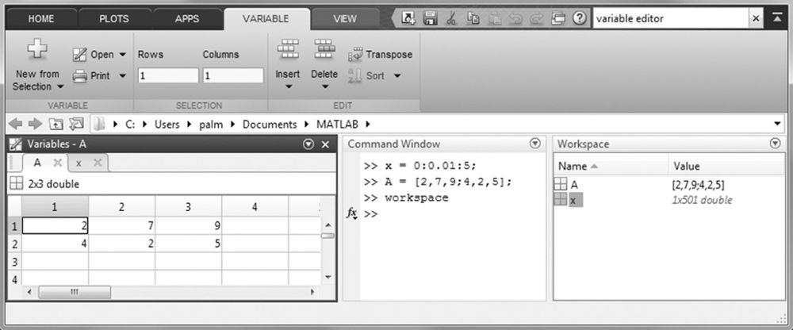
The Workspace Browser and Variable Editor
Source: MATLAB

Slide 27
Multidimensional Arrays
They consist of two-dimensional matrices “layered” to produce a third dimension. Each “layer” is called a page.
cat(n,A,B,C, ...) | Creates a new array by concatenating the arrays A,B,C, and so on along the dimension n.

Slide 28
Array Addition and Subtraction
For example:
Array subtraction is performed in a similar way.
The addition shown in Equation 1 is performed in MATLAB as follows:
>>A = [6,-2;10,3];
>>B = [9,8;-12,14]
>>A+B
ans =
15 6
-2 17

Slide 29
Multiplication 1
Multiplying a matrix A by a scalar w produces a matrix whose elements are the elements of A multiplied by w. For example:
This multiplication is performed in MATLAB as follows:
>>A = [2, 9; 5,−7];
>>3*A
ans =
6 27
15 −21

Slide 30
Multiplication 2
Multiplication of an array by a scalar is easily defined and easily carried out.
However, multiplication of two arrays is not so straightforward.
MATLAB uses two definitions of multiplication:
(1) array multiplication (also called element-by-element multiplication), and
(2) matrix multiplication.

Slide 31
Division and exponentiation
Division and exponentiation must also be carefully defined when you are dealing with operations between two arrays.
MATLAB has two forms of arithmetic operations on arrays. Next, we introduce one form, called array operations, which are also called element-by-element operations. Then we will introduce matrix operations. Each form has its own applications.

Slide 32


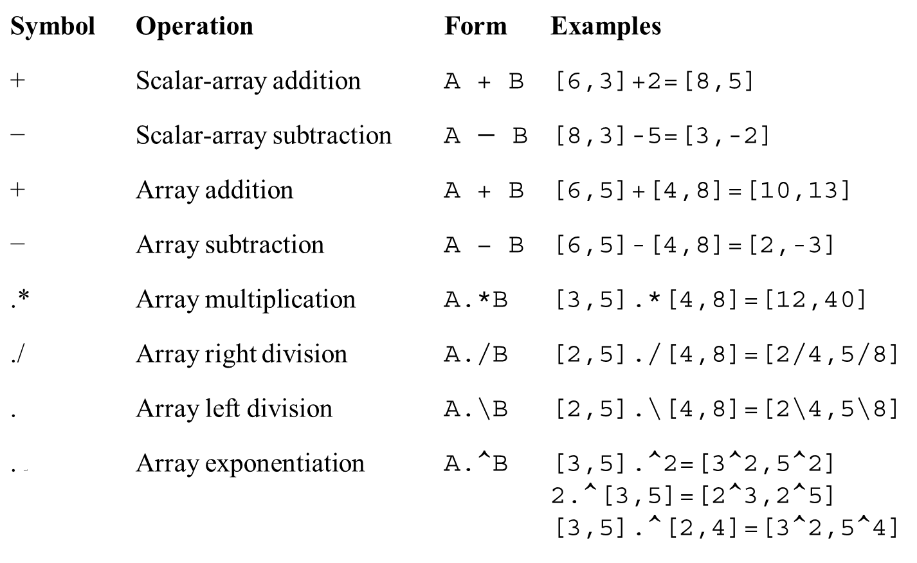
Element-by-element operations 1
Symbol | Operation | Form | Examples
+ | Scalar-array addition | A + B | [6,3]+2=[8,5]
− | Scalar-array subtraction | A $−$ B | [8,3]-5=[3,-2]
+ | Array addition | A + B | [6,5]+[4,8]=[10,13]
− | Array subtraction | A − B | [6,5]-[4,8]=[2,-3]
.* | Array multiplication | A.*B | [3,5].*[4,8]=[12,40]
./ | Array right division | A./B | [2,5]./[4,8]=[2/4,5/8]
.back slash | Array left division | A.\B | [2,5].\[4,8]=[2\4,5\8]
. and | Array exponentiation | A.^B | [3,5].^2=[3^2,5^2] 2.^[3,5]=[2^3,2^5] [3,5].^[2,4]=[3^2,5^4]

Slide 33
Element-by-element operations 2
Array or Element-by-element multiplication is defined only for arrays having the same size. The definition of the product x.*y, where x and y each have n elements, is
x.*y = [x(1)y(1), x(2)y(2), ... , x(n)y(n)]
if x and y are row vectors. For example, if
x = [2, 4, − 5], y = [− 7, 3, − 8]
then z = x.*y gives

Slide 34
Element-by-element operations 3
If x and y are column vectors, the result of x.*y is a column vector. For example z = (x’).*(y’) gives
Note that x’ is a column vector with size 3 × 1 and thus does not have the same size as y, whose size is 1 × 3.
The operations x’.*y and y.*x’ this will generate a 3 x 3 matrix

Slide 35
Element-by-element operations 4
The array operations are performed between the elements in corresponding locations in the arrays. For example, the array multiplication operation A.*B results in a matrix C that has the same size as A and B and has the elements
. For example, if
then C = A.*B gives this result:

Slide 36
Element-by-element operations 5
The built-in MATLAB functions such as sqrt(x) and exp(x) automatically operate on array arguments to produce an array result the same size as the array argument x.
Thus, these functions are said to be vectorized functions.
For example, in the following session the result y has the same size as the argument x.
>>x = [4, 16, 25];
>>y = sqrt(x)
y =
2 4 5

Slide 37
Element-by-element operations 6
However, when multiplying or dividing these functions, or when raising them to a power, you must use element-by-element operations if the arguments are arrays.
For example, to compute z =
, you must type
z = exp(y).*sin(x).*(cos(x)).^2.
You will get an error message if the size of x is not the same as the size of y. The result z will have the same size as x and y.

Slide 38
Array Division 1
The definition of array division is similar to the definition of array multiplication except that the elements of one array are divided by the elements of the other array. Both arrays must have the same size. The symbol for array right division is ./.
For example, if
x = [8, 12, 15] y = [−2, 6, 5]
then z = x./y gives

Slide 39
Array Division 2
Also, if
gives
then C = A./B

Slide 40
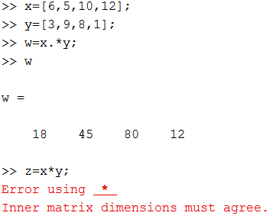
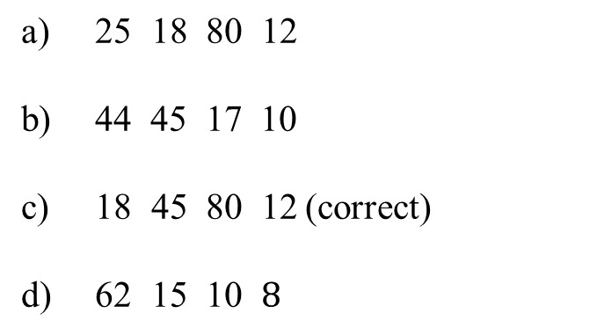
Q4- Given the vectors x = [ 6 5 10 12 ] and y = [ 3 9 8 1]
The product w = x.*y is:
$\text{25} \text{18}\text{ 80 12}$
44 45 17 10
$\text{18 45 80 12}$ (correct)
$\text{62} \text{1}\text{5 }\text{1}\text{0 }8$

Slide 41
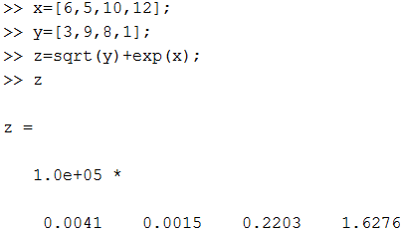
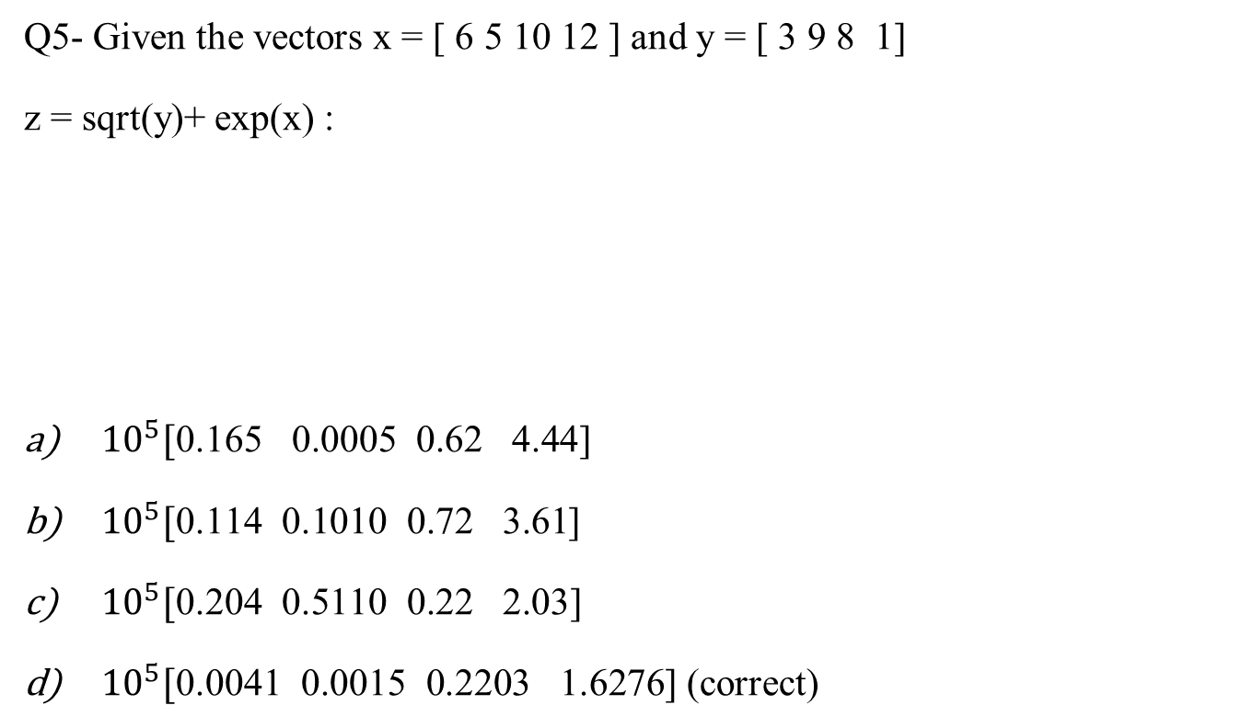
Q5- Given the vectors x = [ 6 5 10 12 ] and y = [ 3 9 8 1]
z = sqrt(y)+ exp(x) :
${10}^{5}[\text{0.165} \text{ 0}\text{.}\text{000}\text{5} \text{ 0.}\text{6}\text{2 }\text{4}\text{.}\text{44}\text{]}$
${10}^{5}[\text{0.114} \text{0.1010} \text{ 0.72 3.61}$]
${10}^{5}[\text{0.204} \text{0.5110} \text{ 0.22 2.03}\text{]}$
${10}^{5}[\text{0.004}\text{1} \text{0.0015} \text{ 0.22}\text{03}\text{ 1.6}\text{276}$] (correct)

Slide 42
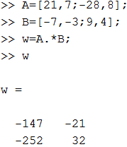
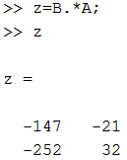
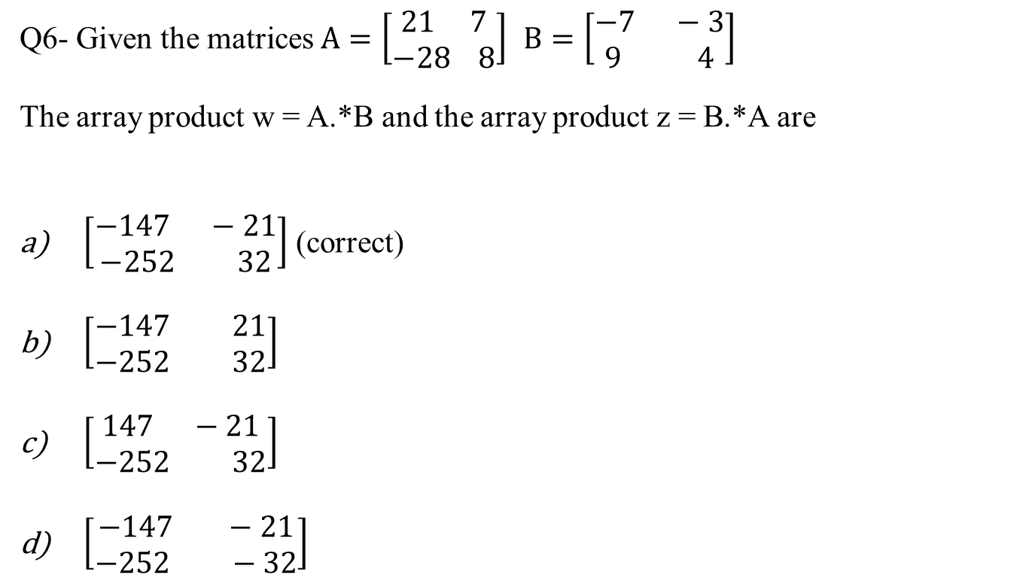
Q6- Given the matrices $A=\left[\begin{aligned}21 7 \\ −28 8\end{aligned}\right]$ $B=\left[\begin{aligned}−7 −3 \\ 9 4\end{aligned}\right]$
The array product w = A.*B and the array product z = B.*A are
$\left[\begin{aligned}−147 −21 \\ −252 32\end{aligned}\right]$ (correct)
$\left[\begin{aligned}−147 21 \\ −252 32\end{aligned}\right]$
$\left[\begin{aligned}147 −21 \\ −252 32\end{aligned}\right]$
$\left[\begin{aligned}−147 −21 \\ −252 −32\end{aligned}\right]$

Slide 43
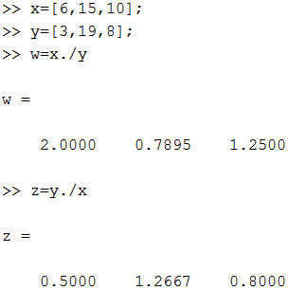
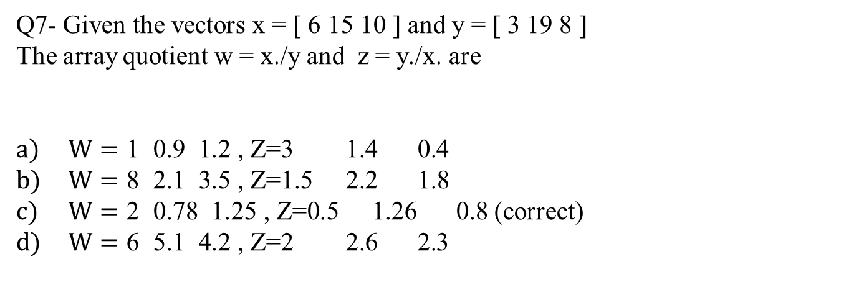
Q7- Given the vectors x = [ 6 15 10 ] and y = [ 3 19 8 ]
The array quotient w = x./y and z = y./x. are
$W=\text{1} \text{ 0.9 1.2} \text{,} \text{Z}\text{=3 1.4 0.}$4
$W=\text{8} \text{ 2.1 3.5} \text{,} \text{Z}\text{=1.5 2.2 1.8}$
$W=\text{2} \text{ 0.}\text{78}\text{ 1.}\text{25} \text{,} \text{Z}\text{=0.5 1.}\text{26}\text{ 0.8}$ (correct)
$W=\text{6} \text{ 5.1 4.2 , }\text{Z}\text{=2 2.6 2.}$3

Slide 44
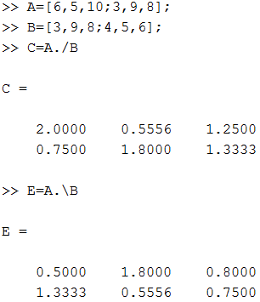
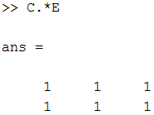
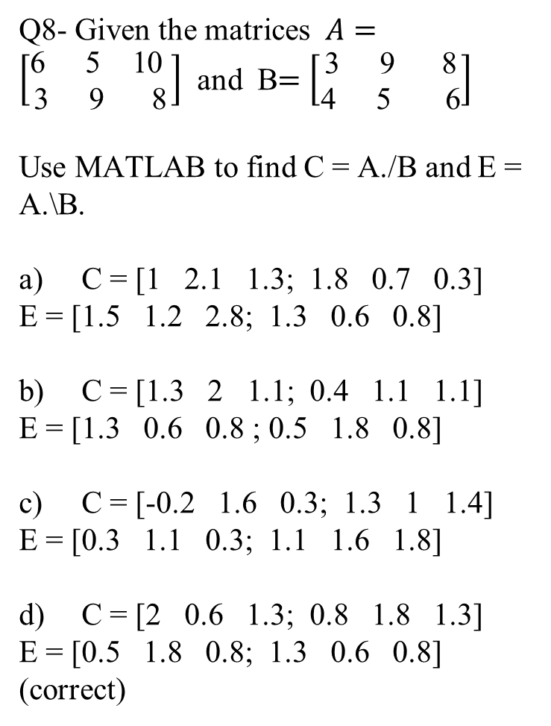
Q8- Given the matrices $A=\left[\begin{aligned}\text{6 } \text{5 } \text{10 } \\ \text{3} \text{ 9 } \text{8}\end{aligned}\right]$ and B$=\left[\begin{aligned}\text{3} \text{ 9 } \text{8} \\ \text{4 } \text{5} \text{ 6}\end{aligned}\right]$
Use MATLAB to find C = A./B and E = A.\B.
C = [1 2.1 1.3; 1.8 0.7 0.3] E = [1.5 1.2 2.8; 1.3 0.6 0.8]
C = [1.3 2 1.1; 0.4 1.1 1.1] E = [1.3 0.6 0.8 ; 0.5 1.8 0.8]
C = [-0.2 1.6 0.3; 1.3 1 1.4] E = [0.3 1.1 0.3; 1.1 1.6 1.8]
C = [2 0.6 1.3; 0.8 1.8 1.3] E = [0.5 1.8 0.8; 1.3 0.6 0.8] (correct)

Slide 45
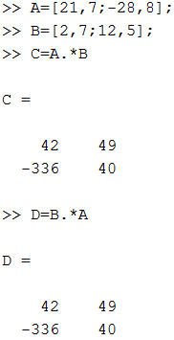

Q9- Given the matrices $A=\left[\begin{aligned}21 7 \\ −28 8\end{aligned}\right]$ and $B=\left[\begin{aligned}2 7 \\ 12 5\end{aligned}\right]$
Their array product is
$C=\left[\begin{aligned}42 49 \\ −336 40\end{aligned}\right]$ (correct)
$C=\left[\begin{aligned}−142 29 \\ 14 63\end{aligned}\right]$
$C=\left[\begin{aligned}234 249 \\ 162 −40\end{aligned}\right]$
$C=\left[\begin{aligned}21 43 \\ −136 48\end{aligned}\right]$

Slide 46
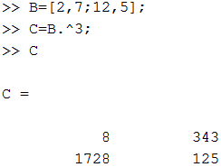
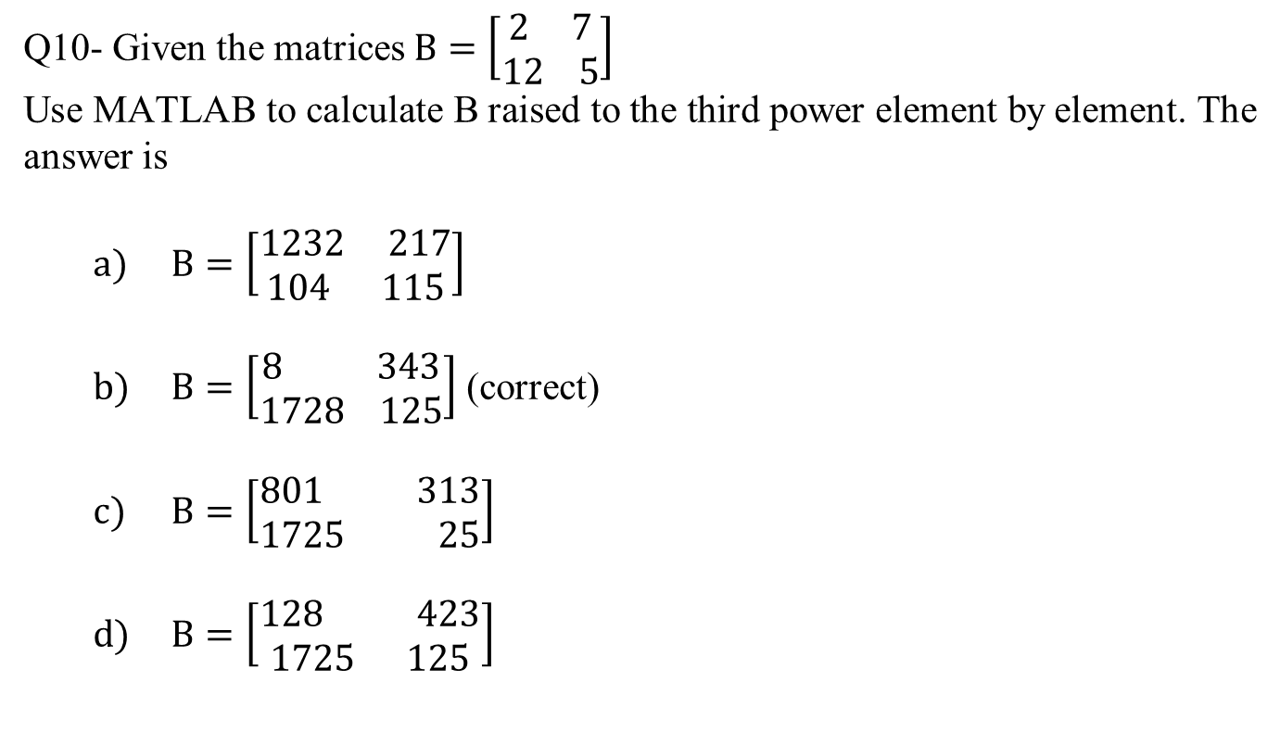
Q10- Given the matrices $B=\left[\begin{aligned}2 7 \\ 12 5\end{aligned}\right]$
Use MATLAB to calculate B raised to the third power element by element. The answer is
$B=\left[\begin{aligned}1232 217 \\ 104 115\end{aligned}\right]$
$B=\left[\begin{aligned}8 343 \\ 1728 125\end{aligned}\right]$ (correct)
$B=\left[\begin{aligned}801 313 \\ 1725 25\end{aligned}\right]$
$B=\left[\begin{aligned}128 423 \\ 1725 125\end{aligned}\right]$

Slide 47
Array Exponentiation 1
MATLAB enables us not only to raise arrays to powers but also to raise scalars and arrays to array powers.
To perform exponentiation on an element-by-element basis, we must use the .^
symbol.
For example, if x = [3, 5, 8], then typing x.^3
produces the array

Slide 48
Array Exponentiation 2
We can raise a scalar to an array power. For example, if p = [2, 4, 5], then typing 3.^p produces the array
Remember that .^ is a single symbol. The dot in 3.^p is not a decimal point associated with the number 3. The following operations, with the value of p given here, are equivalent and give the correct answer:
3.^p
3.0.^p
3..^p
(3).^p
3.^[2,4,5]

Slide 49
Matrix-Matrix Multiplication 1
In the product of two matrices AB, the number of columns in A must equal the number of rows in B. The row-column multiplications form column vectors, and these column vectors form the matrix result. The product AB has the same number of rows as A and the same number of columns as B. For example,

Slide 50
Matrix-Matrix Multiplication 2
Use the operator * to perform matrix multiplication in MATLAB. The following MATLAB session shows how to perform matrix multiplication.
>>A = [6,-2;10,3;4,7];
>>B = [9,8;-5,12];
>>A*B
ans =
64 24
75 116
1 116

Slide 51
Matrix-Matrix Multiplication 3
Matrix multiplication does not have the commutative property; that is, in general, AB
BA. A simple example will
demonstrate this fact:
whereas
Reversing the order of matrix multiplication is a common and easily made mistake.

Slide 52
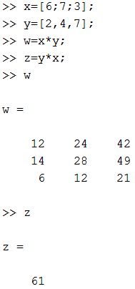
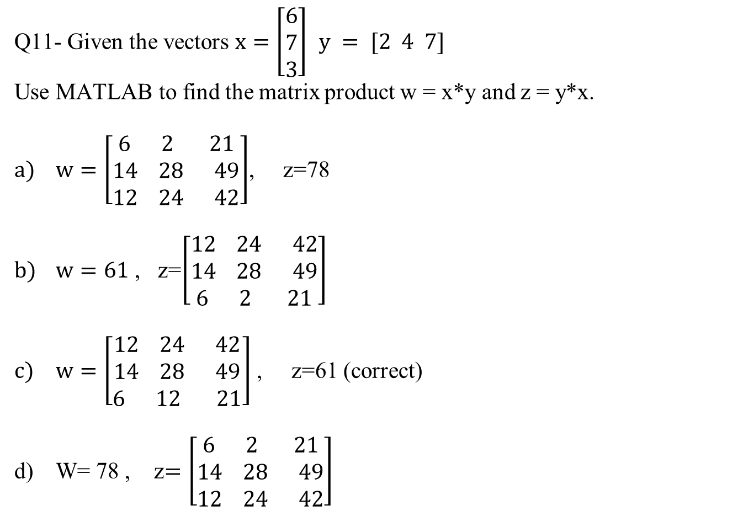
Q11- Given the vectors $x=\left[\begin{aligned}6 \\ 7 \\ 3\end{aligned}\right]$ $y = [2 4 7]$
Use MATLAB to find the matrix product w = x*y and z = y*x.
$w=\left[\begin{aligned}6 2 21 \\ 14 28 49 \\ 12 24 42\end{aligned}\right]$, z=78
$w=61$ , z=$\left[\begin{aligned}12 24 42 \\ 14 28 49 \\ 6 2 21\end{aligned}\right]$
$w=\left[\begin{aligned}12 24 42 \\ 14 28 49 \\ 6 12 21\end{aligned}\right]$ , z=61 (correct)
W= 78 , z$=\left[\begin{aligned}6 2 21 \\ 14 28 49 \\ 12 24 42\end{aligned}\right]$

Slide 53
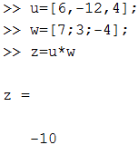

Q12- Use MATLAB to compute the dot product of the following vectors:
$u = 6i −12j +4k$ $w =7i + 3j −4k$
-6
7
-10 (correct)
12

Slide 54
Special Matrices 1
Two exceptions to the noncommutative property are the null or zero matrix, denoted by 0 and the identity, or unity, matrix, denoted by I.
The null matrix contains all zeros and is not the same as the empty matrix
, which has no elements.
These matrices have the following properties:
0A = A0 = 0
IA = AI = A

Slide 55
Special Matrices 2
The identity matrix is a square matrix whose diagonal elements are all equal to one, with the remaining elements equal to zero.
For example, the 2 × 2 identity matrix is
The functions eye(n) and eye(size(A)) create an n × n identity matrix and an identity matrix the same size as the matrix A.

Slide 56
Special Matrices 3
Sometimes we want to initialize a matrix to have all zero elements. The zeros command creates a matrix of all zeros.
Typing zeros(n) creates an n × n matrix of zeros, whereas typing zeros(m,n) creates an m × n matrix of zeros.
Typing zeros(size(A)) creates a matrix of all zeros having the same dimension as the matrix A. This type of matrix can be useful for applications in which we do not know the required dimension ahead of time.
The syntax of the ones command is the same, except that it creates arrays filled with ones.

Slide 57

Matrix Left Division and Linear Equations
6x + 12y + 4z = 70
7x − 2y + 3z = 5
2x + 8y − 9z = 64
>>A = [6,12,4;7,-2,3;2,8,-9];
>>B = [70;5;64];
>>Solution = A\B
Solution =
3
5
-2
The solution is x $=$ 3, y $=$ 5, and z $=$ −2.

Slide 58

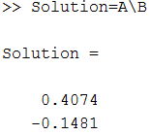

Q13- Use MATLAB to solve the following set of equations.
$$14x − 2y =6$$
$$3 x +15y = −1$$
0.41, -0.15 (correct)
-0.67, 0.71
0.93, 0.17
1.41, -2.43

Slide 59
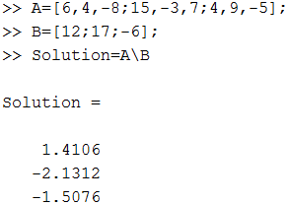

Q14- Use MATLAB to solve the following set of equations.
$$6x+ 4y − 8z=12$$
$$15x − 3y + 7z =17$$
$$4x + 9y − 5z=− 6$$
2.1, 3.1, -2.5
1.4, -2.1, -1.5 (correct)
1.2, -0.1, 0.5
4.4, -8.1, 3.5

Slide 60
Polynomial Coefficients
The function poly(r)computes the coefficients of the polynomial whose roots are specified by the vector r. The result is a row vector that contains the polynomial’s coefficients arranged in descending order of power.
For example,
>>c = poly([-2, -5])
c =
1 7 10

Slide 61
Polynomial Roots
The function roots(a)computes the roots of a polynomial specified by the coefficient array a. The result is a column vector that contains the polynomial’s roots.
For example,
>>r = roots([2, 14, 20])
r =
-2
-5

Slide 62
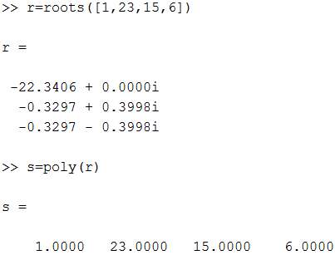
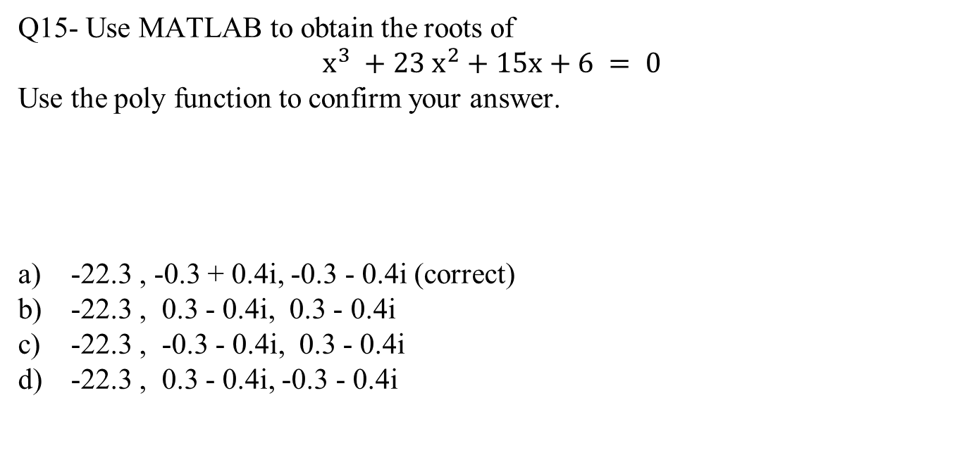
Q15- Use MATLAB to obtain the roots of
$$x^{3} +23 x^{2}+15x+6 = 0$$
Use the poly function to confirm your answer.
-22.3 , -0.3 + 0.4i, -0.3 - 0.4i (correct)
-22.3 , 0.3 - 0.4i, 0.3 - 0.4i
-22.3 , -0.3 - 0.4i, 0.3 - 0.4i
-22.3 , 0.3 - 0.4i, -0.3 - 0.4i

Slide 63
Polynomial Multiplication and Division
The function conv(a,b) computes the product of the two polynomials described by the coefficient arrays a and b. The two polynomials need not be the same degree. The result is the coefficient array of the product polynomial.
The function [q,r] = deconv(num,den) computes the result of dividing a numerator polynomial, whose coefficient array is num, by a denominator polynomial represented by the coefficient array den. The quotient polynomial is given by the coefficient array q, and the remainder polynomial is given by the coefficient array r.

Slide 64
Polynomial Multiplication and Division: Examples
>>a = [9,-5,3,7];
>>b = [6,-1,2];
>>product = conv(a,b)
product =
54 -39 41 29 -1 14
>>[quotient, remainder] = deconv(a,b)
quotient =
1.5 -0.5833
remainder =
0 0 -0.5833 8.1667

Slide 65

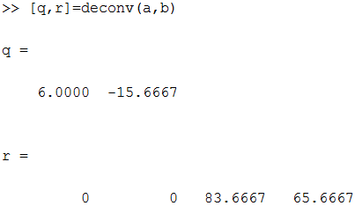
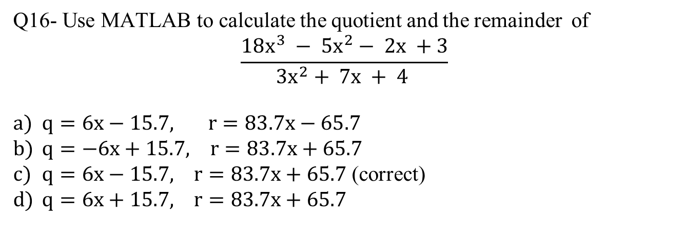
Q16- Use MATLAB to calculate the quotient and the remainder of
$$\frac{18x^{3} − 5x^{2}− 2x +3}{3x^{2}+ 7x + 4 }$$
$q=6x−15.7, r=83.7x−65.7$
$q=−6x+15.7, r=83.7x+65.7$
$q=6x−15.7, r=83.7x+65.7$ (correct)
$q=6x+15.7, r=83.7x+65.7$

Slide 66
Plotting Polynomials
The function polyval(a,x)evaluates a polynomial at specified values of its independent variable x, which can be a matrix or a vector. The polynomial’s coefficients of descending powers are stored in the array a. The result is the same size as x.

Slide 67
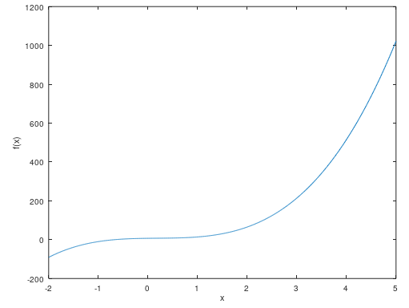

Example of Plotting a Polynomial
To plot the polynomial f (x) =
+ 3x + 7 for − 2 ≤ x
≤ 5, you type
>>a = [9,-5,3,7];
>>x = -2:0.01:5;
>>f = polyval(a,x);
>>plot(x,f),xlabel(’x’),ylabel(’f(x)’)
OR

Slide 68
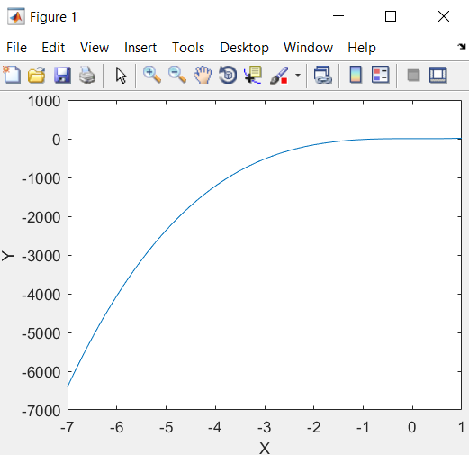

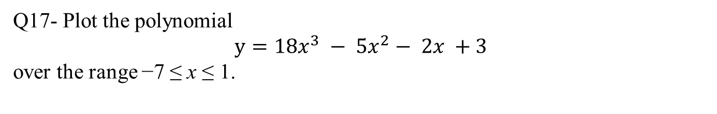
Q17- Plot the polynomial
$$y=18x^{3} − 5x^{2}− 2x +3$$
over the range −7 ≤ x ≤ 1.

Slide 69
Cell Array Functions
Function | Description
C = cell(n) | Creates an n × n cell array C of empty matrices.
C = cell(n,m) | Creates an n × m cell array C of empty matrices.
celldisp(C) | Displays the contents of cell array C.
cellplot(C) | Displays a graphical representation of the cell array C.
https://www.mathworks.com/help/matlab/ref/cell.html

Slide 70
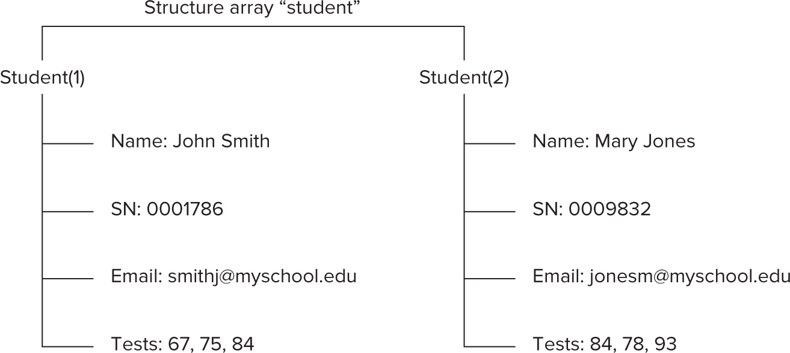
Arrangement of data in the structure array “student”.
https://tinyurl.com/2ubuhpt6

Slide 71
Structure Functions 1
Function | Description
names = fieldnames(S) | Returns the field names associated with the structure array S as names, a cell array of strings.
isfield(S,’field’) | Returns 1 if ’field’ is the name of a field in the structure array S, and 0 otherwise.
isstruct(S) | Returns 1 if the array S is a structure and 0 otherwise.

Slide 72
Structure Functions 2
Function | Description
S = rmfield(S,’field’) | Removes the field ’field’ from the structure array S.
S = struct(’f1’,’v1’, ’f2’,’v2’,...) | Creates a structure array with the fields ’f1’, ’f2’, . . . having the values ’v1’, ’v2’, . . . .

Slide 73
End of Main Content
© McGraw Hill LLC. All rights reserved. No reproduction or distribution without the prior written consent of McGraw Hill LLC.

